Slide 1
Graphic Medicine Online
A. David Lewis, PH.D. MCPHS UNIVERSITY
Presented aS Part of NEMLA 2020’s “Saving the Day: Accessing Comics in the 21st Century”
March 7, 2020 – Boston, MA
Notes:
Thank you to the NEMLA for the opportunity to speak today and to Mike Torregrossa for organizing this panel. In the brief time that I have, I would like to highlight a number of the online and digital options available to readers, creators, or scholars in Graphic Medicine. For better or for worse, this will be a representative sample rather than a comprehensive one since, nicely, this growing engagement between the comics medium and healthcare, medicine, education, and patient experience is expanding yearly. Therefore, this is less a primer on the subject and more of a peek in the digital toolbox to which we are dedicating more scholarly workshop space annually.

Slide 2
WEBSITES
This Photo by Unknown Author is licensed under CC BY-SA
Notes:
Let’s start with the most prominent websites, though, I promise, this presentation will go beyond a tour of URLs and links that Google could easily generate.

Slide 3
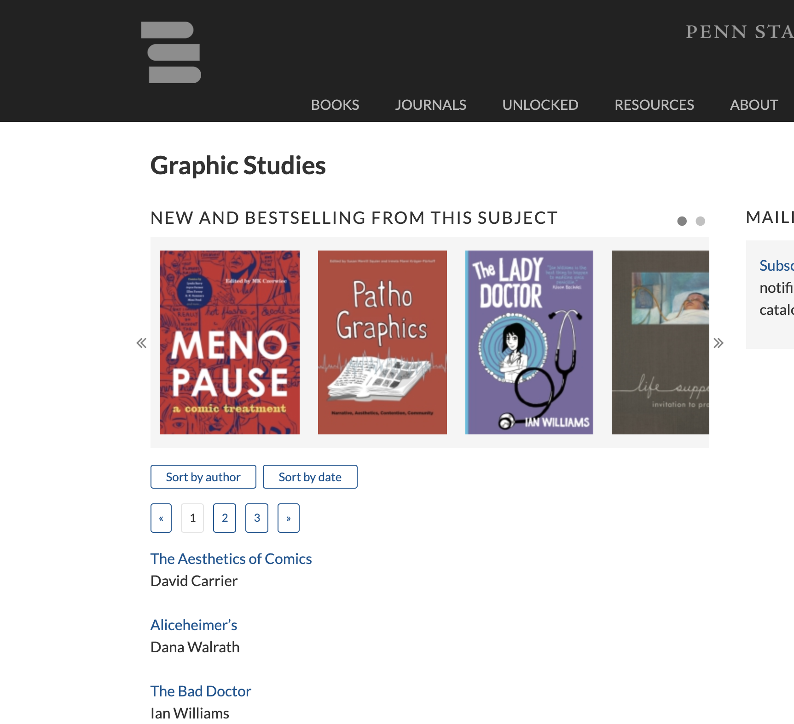
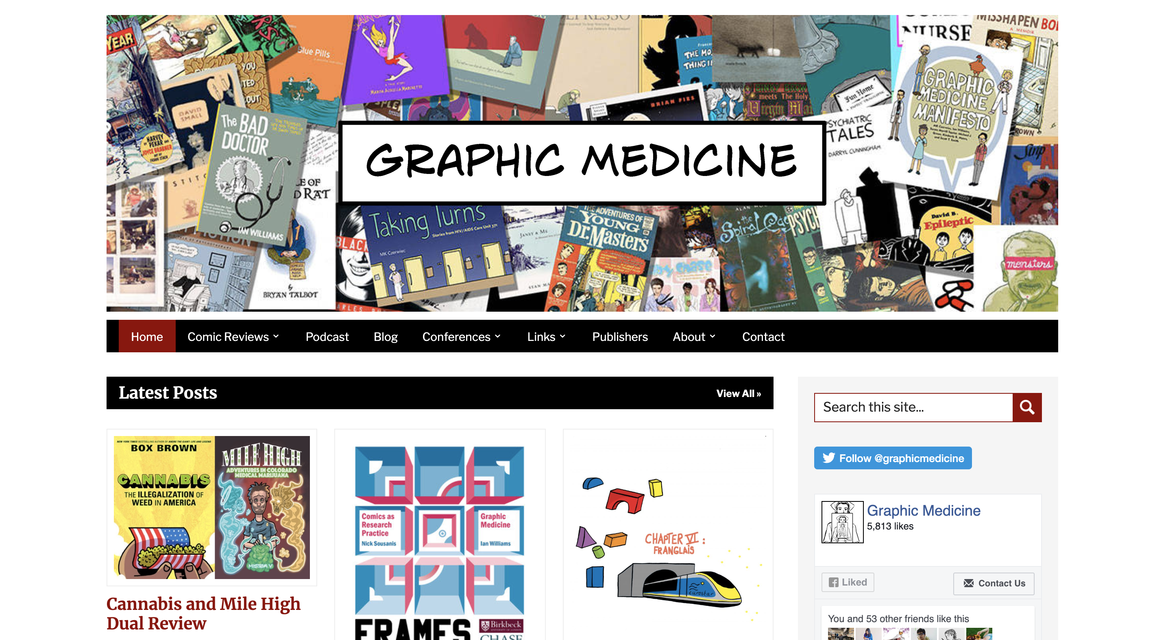
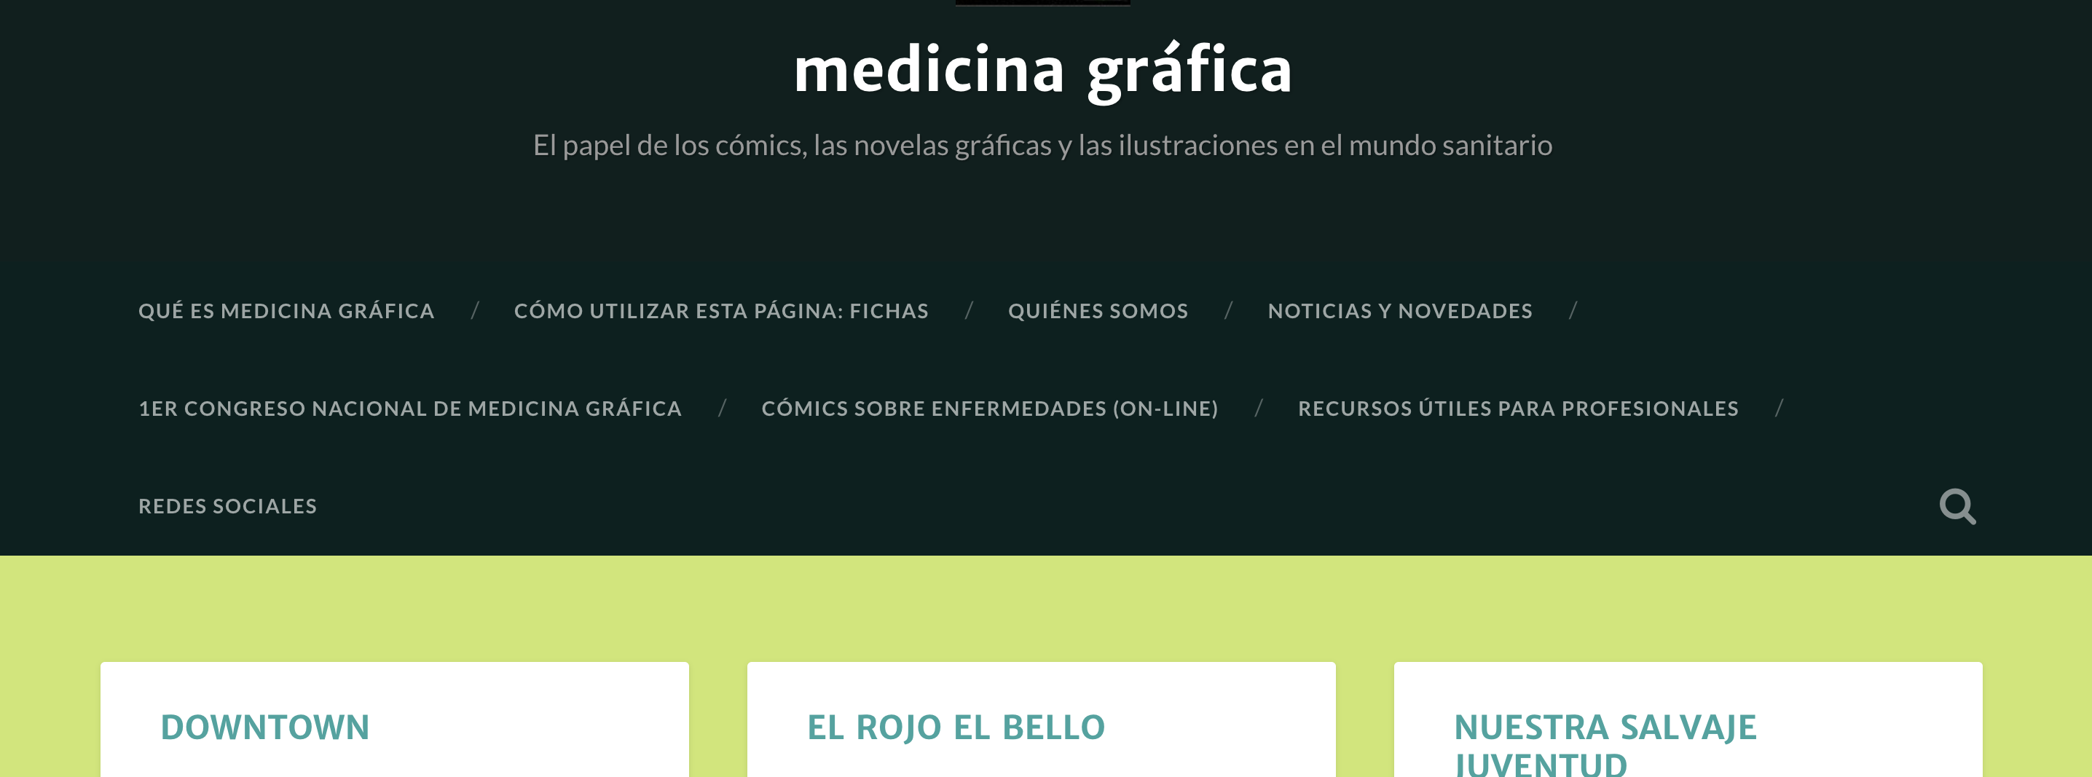
Notes:
If you access only one site on Graphic Medicine, it should be GraphicMedicine.org, essentially the homesite of the field and founded by its most early proponents. In no small way, this group of dedicated scholars, creators, and clinicians led to the Penn State University Press creating its own Graphic Medicine imprint and catalog of titles. Though, of course, the comics medium and concern over healthcare is not an exclusively North American nor English-language concern, and sites like Medicinia Grafica are attempting their own work in languages foreign to our own.

Slide 4
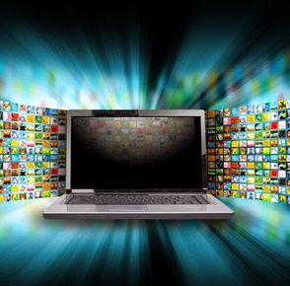
MEDIA
This Photo by Unknown Author is licensed under CC BY-ND
Notes:
One aspect of digital media that I will not have the chance to showcase today are the proprietary apps and mobile software being developed for therapeutical, clinical, and entertainment purposes. But it is worth noting that, in addition to the following, they are on the rise and worth consideration.

Slide 5
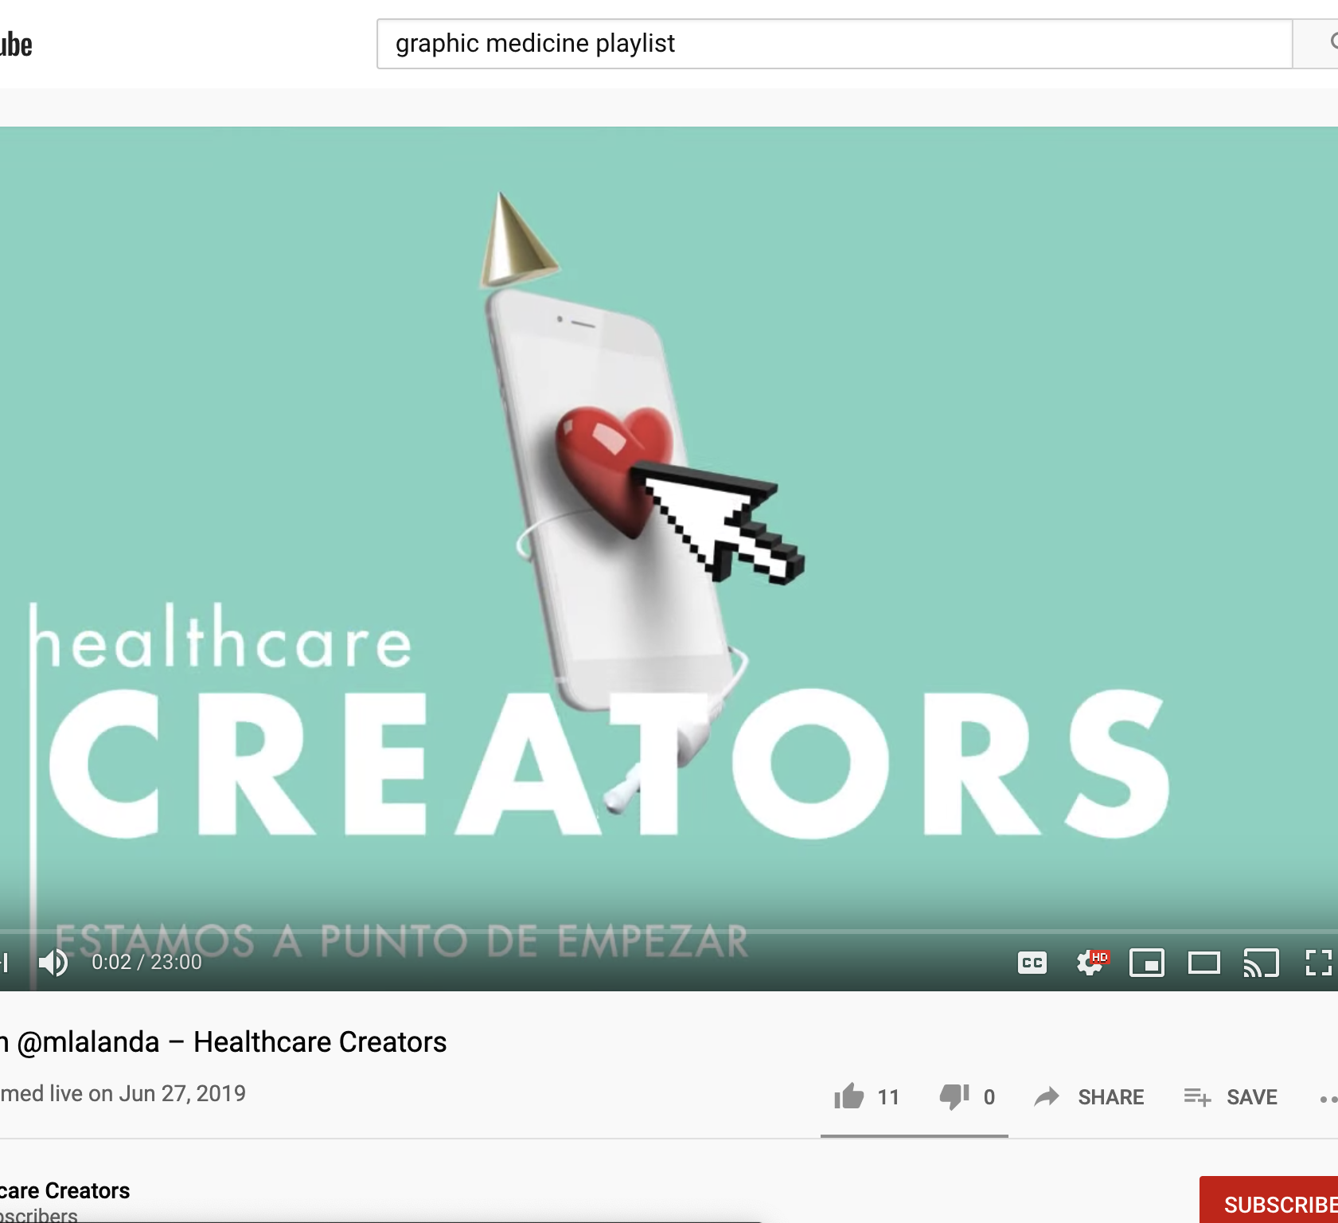
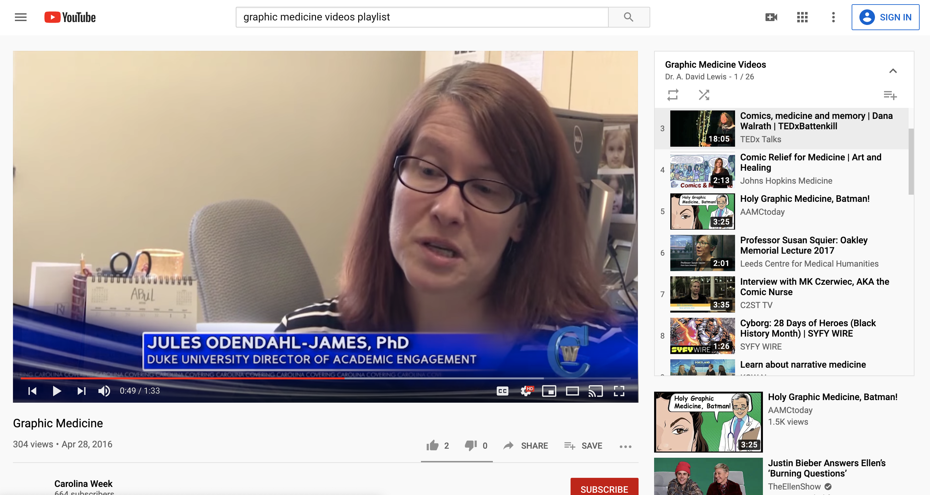
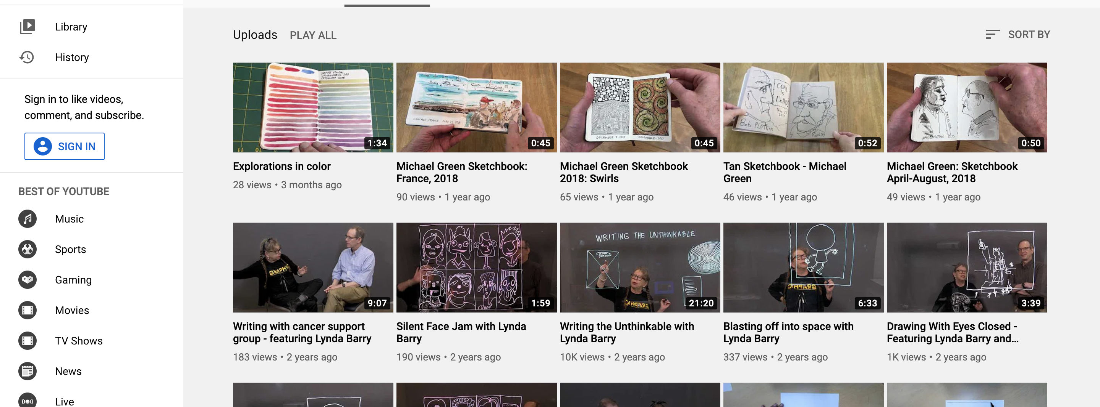
Notes:
YouTube offers a great deal in terms of videos relevant to Graphic Medicine. Even better, it offer a number of curated playlists and channels, as seen here. Dr. Michael Green’s Channel features original videos on various aspects of GM, while MK Czerwiec’s Graphic Medicine Playlist or my own Graphic Medicine Videos collection find relevant news stories, projects, and presentations, then pulling them into a shared space.

Slide 6
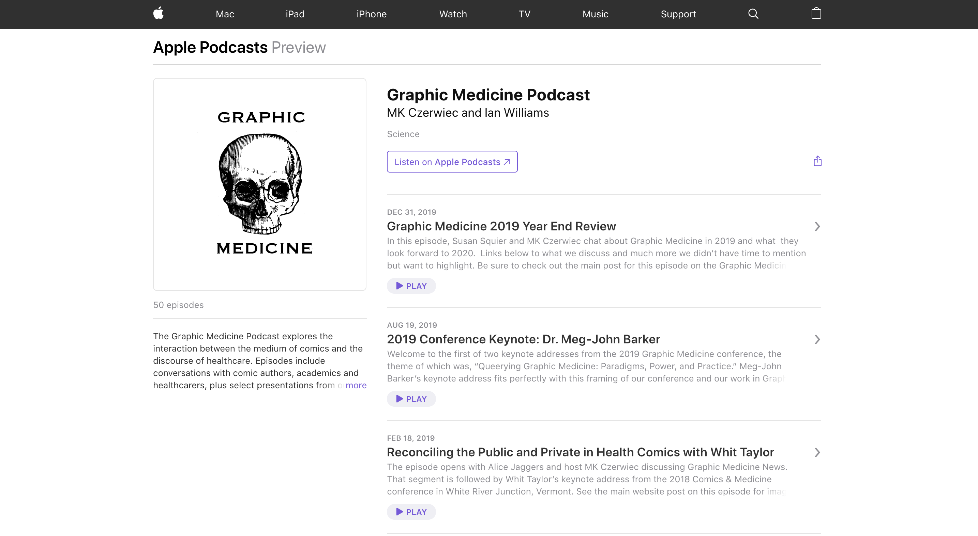
Notes:
Graphic Medicine can also be a subject for the ears as well as the eyes, with the main Graphic Medicine site having expanded into a regular podcast and, at times, a videocast. Original interviews, analyses, and recordings of related conferences make for vital content.

Slide 7
DATABASES
This Photo by Unknown Author is licensed under CC BY-SA-NC
Notes:
We remain in the brilliant, early days of Graphic Medicine, so when I say “databases,” I am not yet referring to major publisher systems like ProQuest of PubMed. Here, I am focusing on our grassroots efforts to amass and more readily make available GM materials.

Slide 8
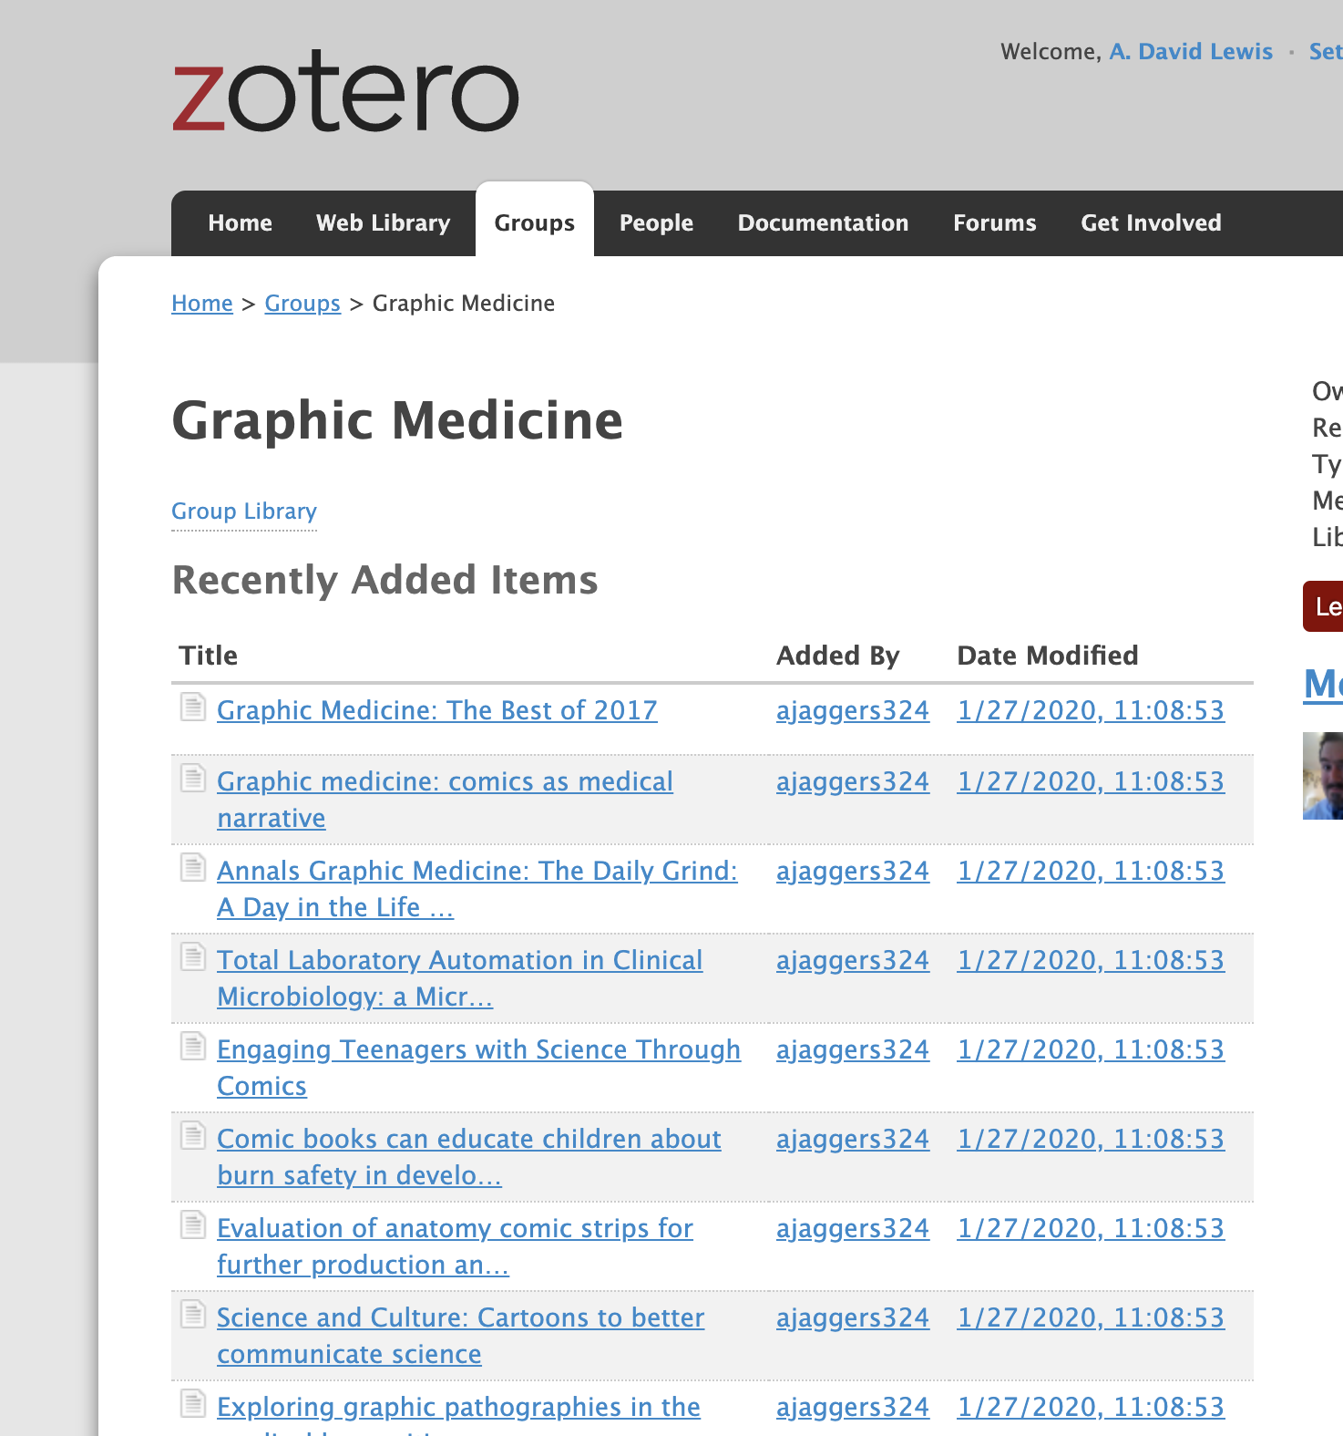
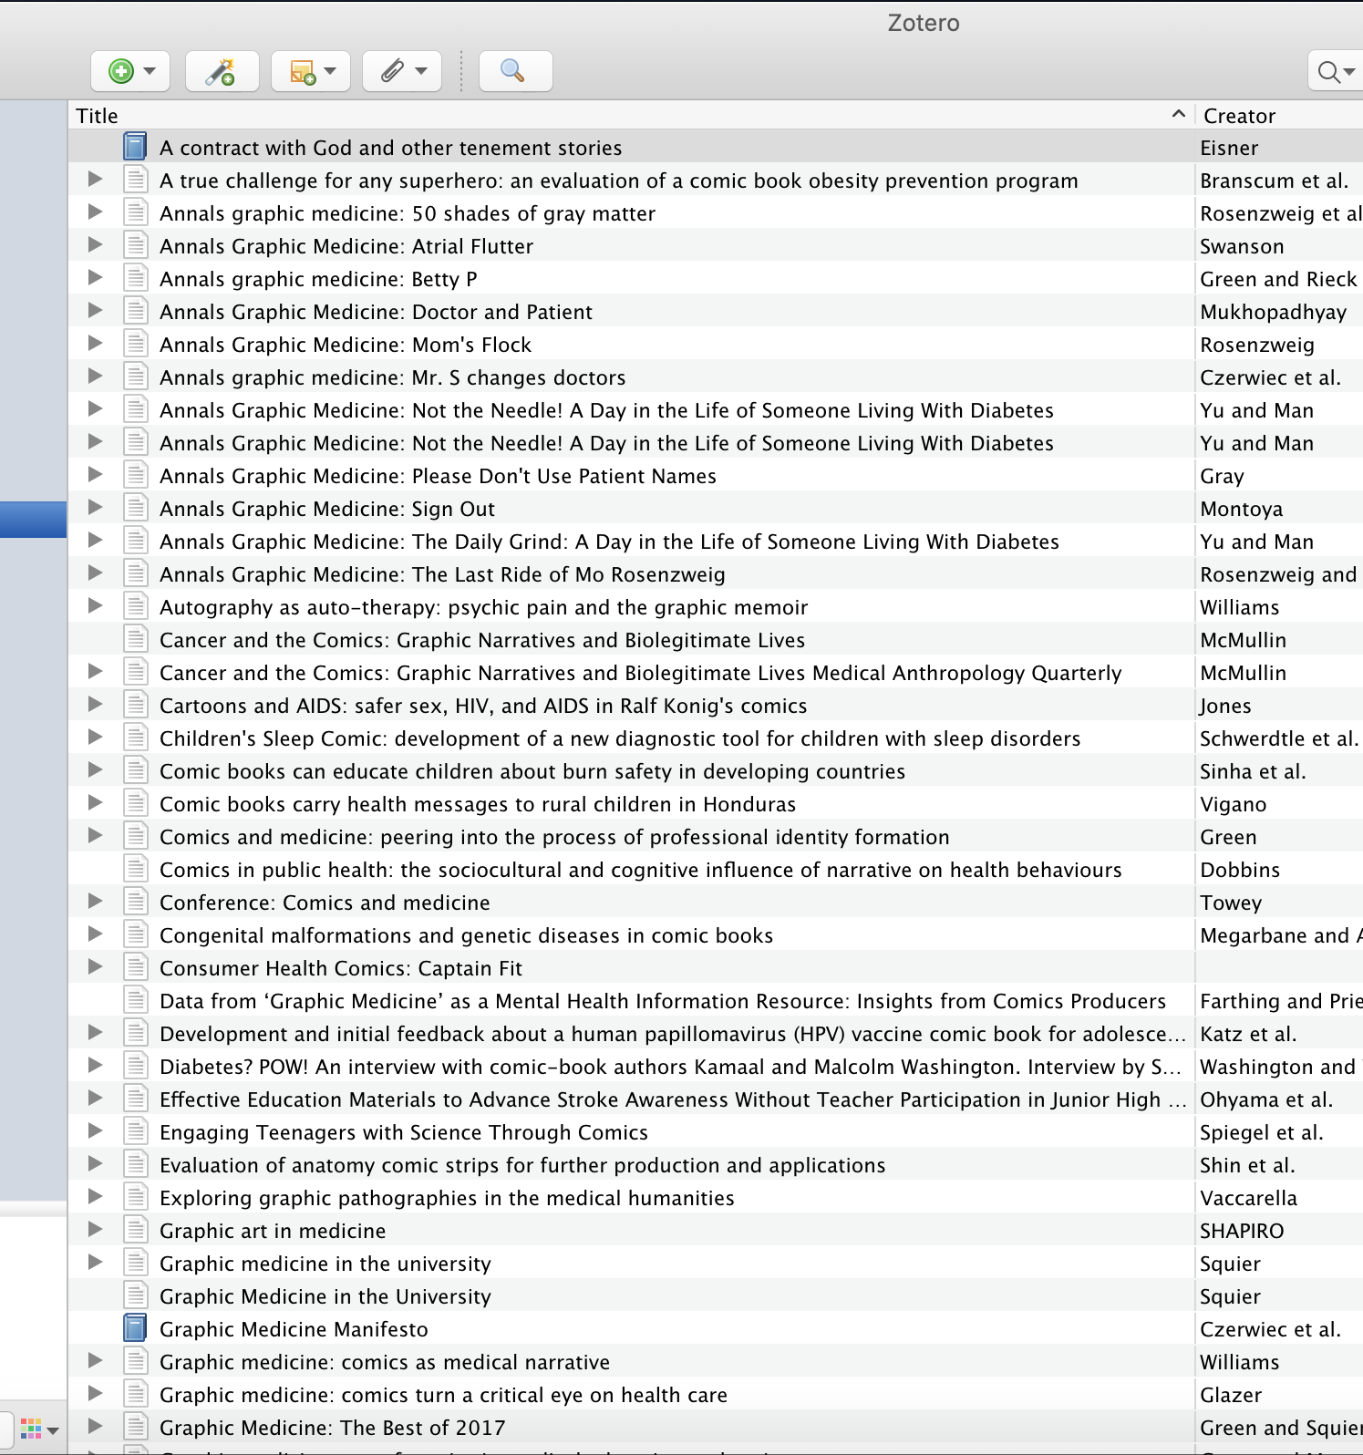
Notes:
Of the many citation and research tools out there, Zotero offers free, shareable group libraries where individuals can collectively build bibliographies and repositories. Its abilities to synch through browsers and laptop software, in tandem, as well as its connection to ISBN and DOI identifiers makes it particularly flexible.

Slide 9
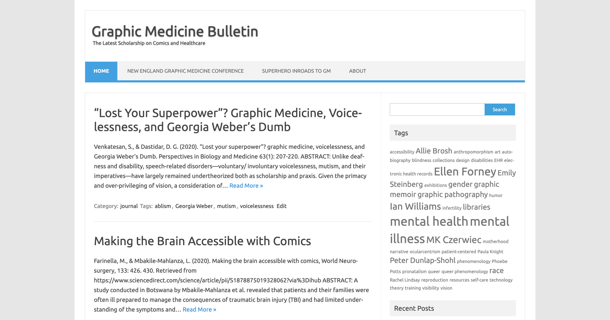
Notes:
Medical librarian Alice Jaggers has made inroads in developing her own open database of GM titles, a list that grows monthly. In parallel, I have attempted to build the Graphic Medicine Bulletin, a searchable snapshot, so to speak, of the latest GM scholarship entering the field. (We will come back to my GMB at the end.)

Slide 10
WEBComics
This Photo by Unknown Author is licensed under CC BY-SA
Notes:
Even as scholars like Jaggers and the Graphic Medicine website track new print publications, immediate and of-the-moment webcomics are offering perspectives on healthcare and illness from all angles.

Slide 11
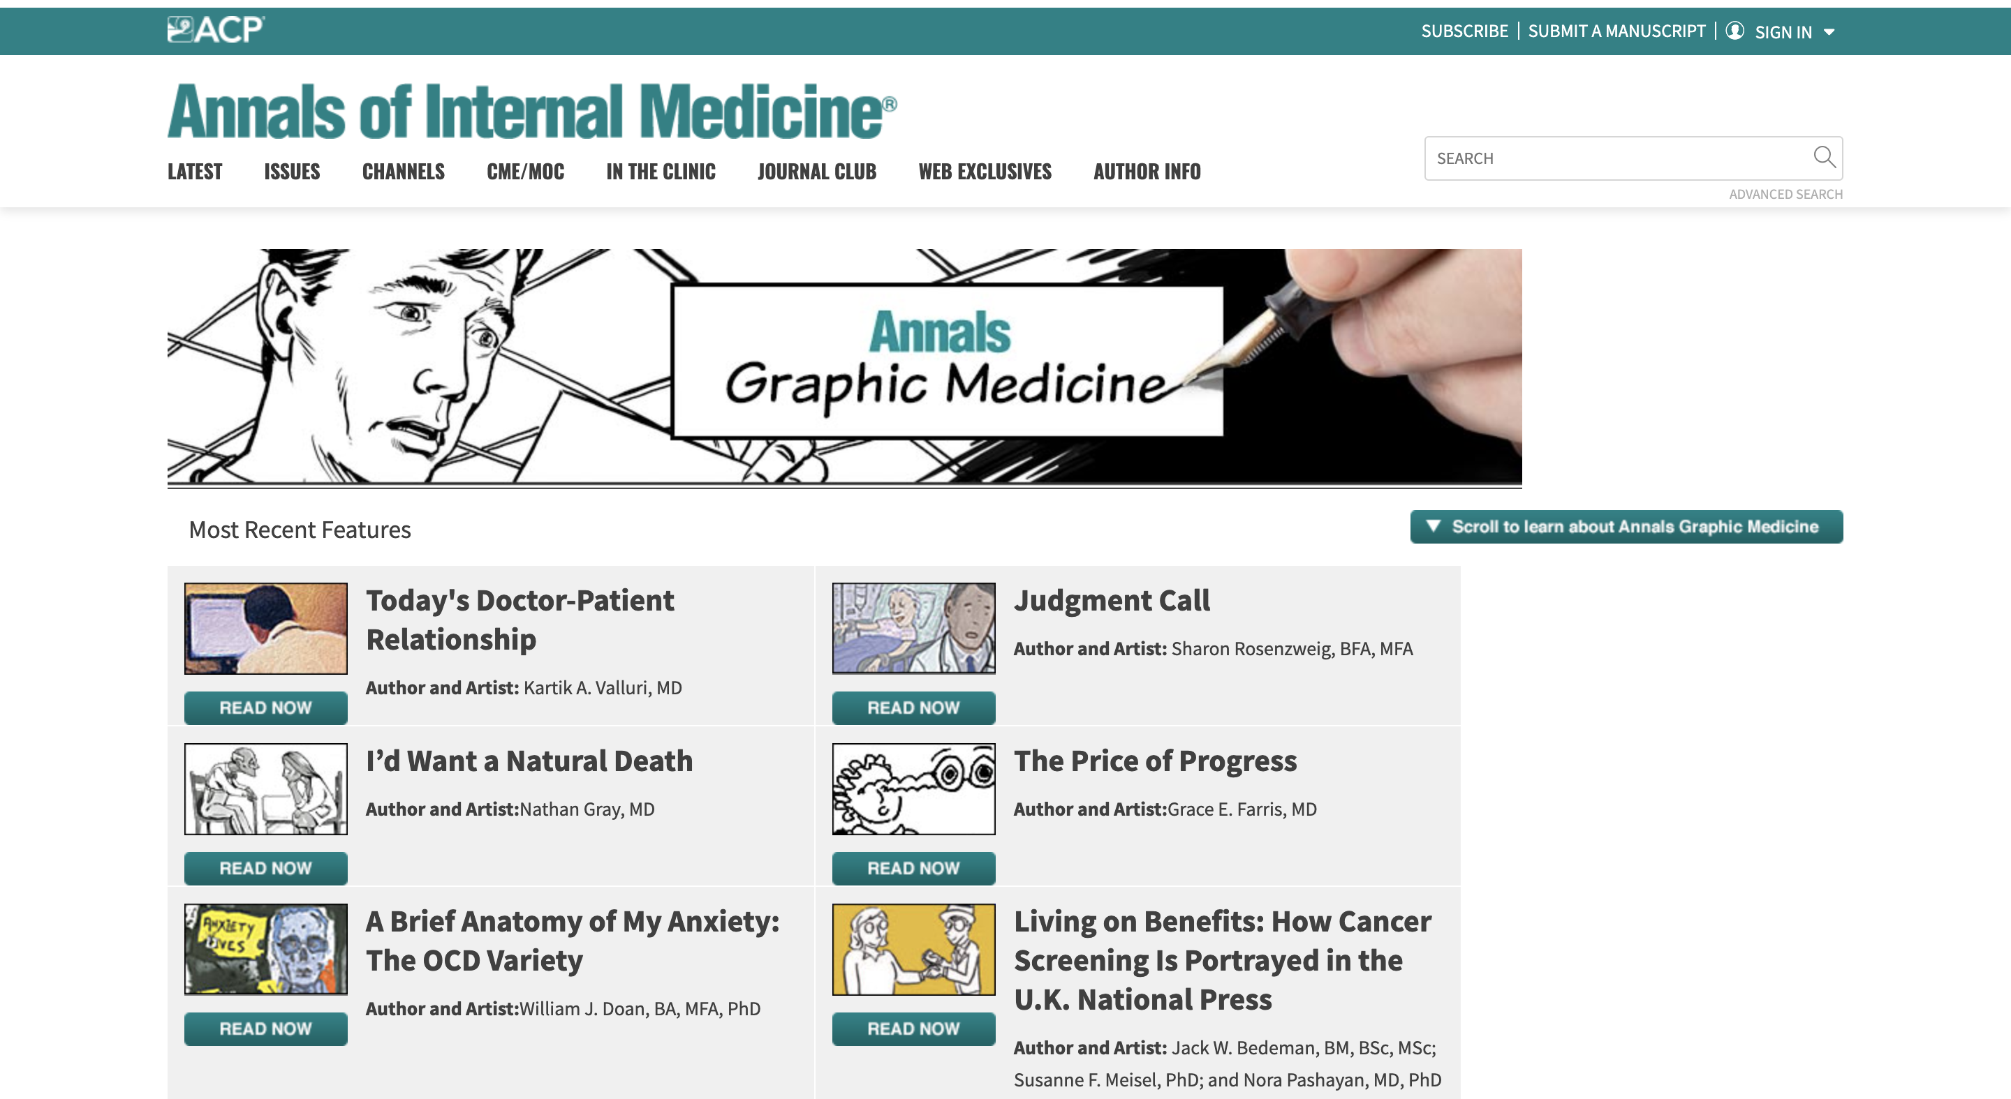
Notes:
The American College of Physicians offers, as a subsite to their Annals of Internal Medicine portal, The Annals of Graphic Medicine, with weekly comics from doctors, nurses, policy experts, and patients.

Slide 12
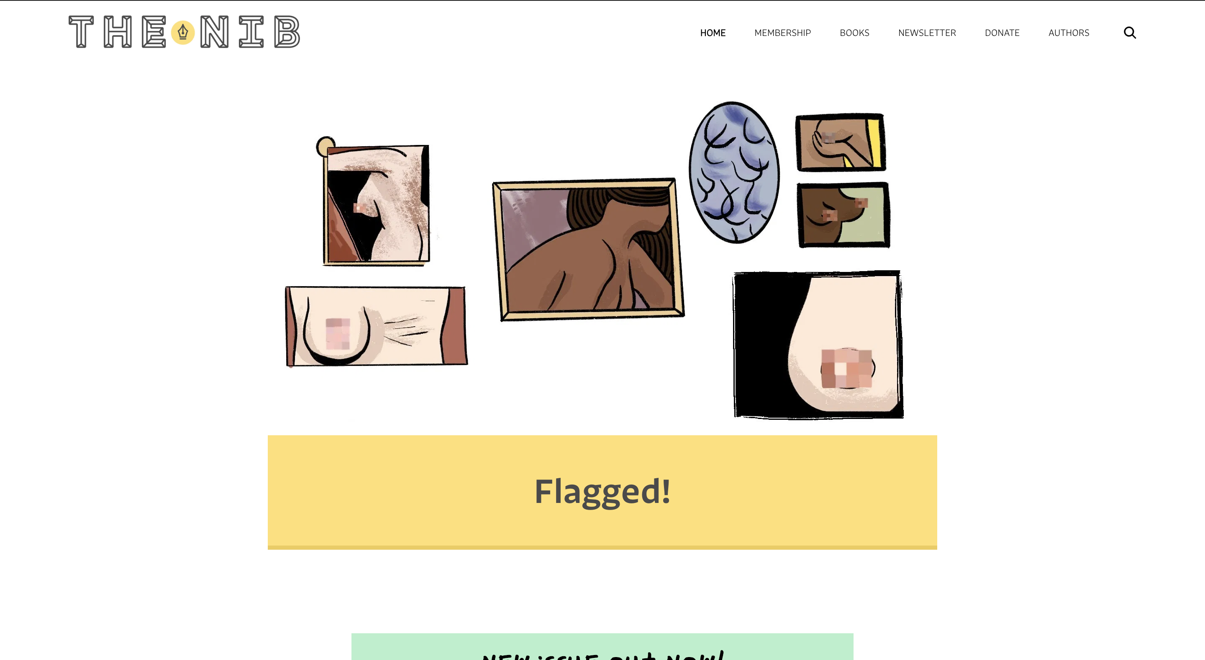
Notes:
Independent comics journalism site The Nib frequently deals in healthcare topics, often noting the impact of the climate crisis on general wellbeing as well as gender issues and public health policy.

Slide 13
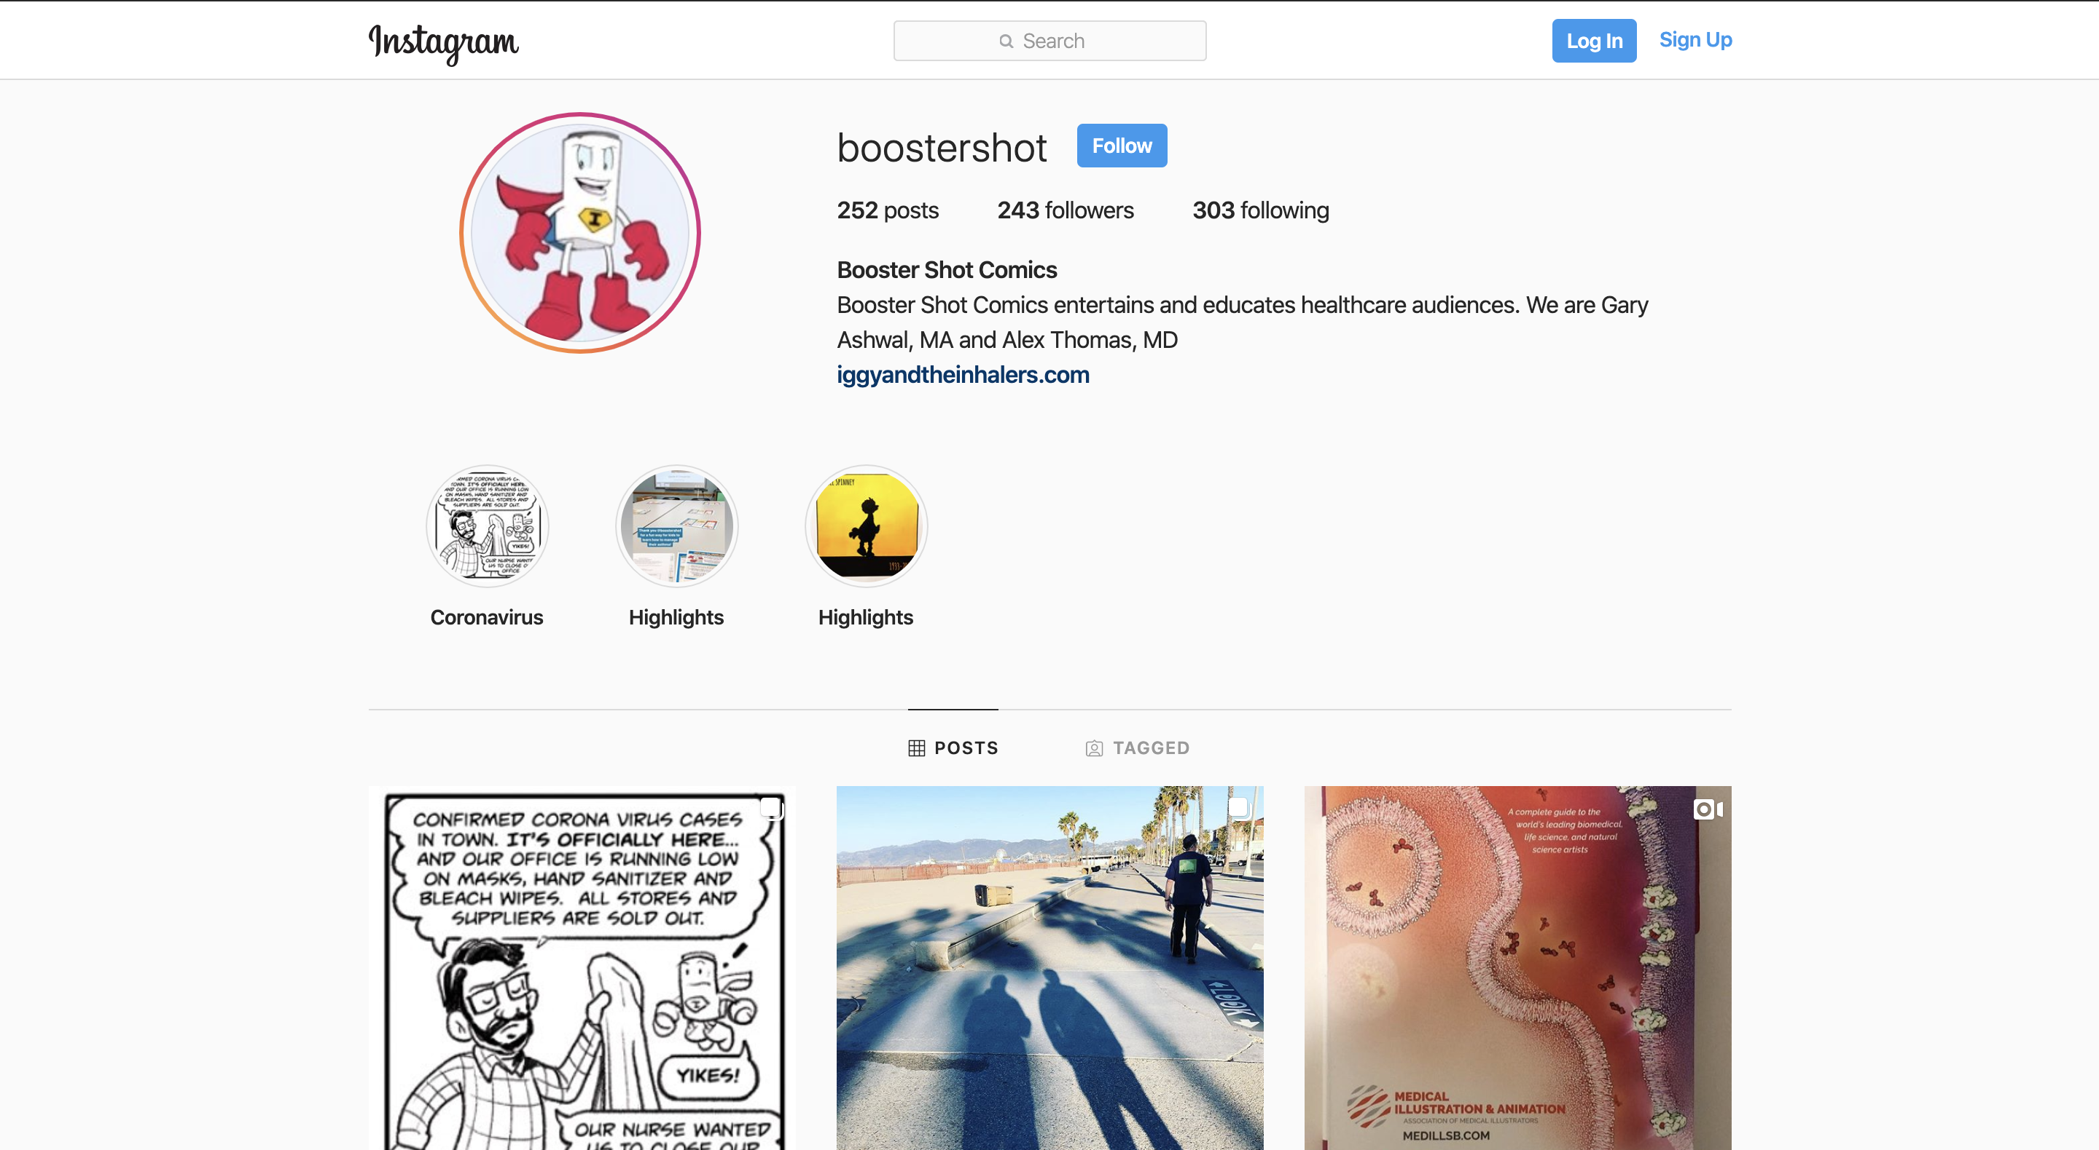
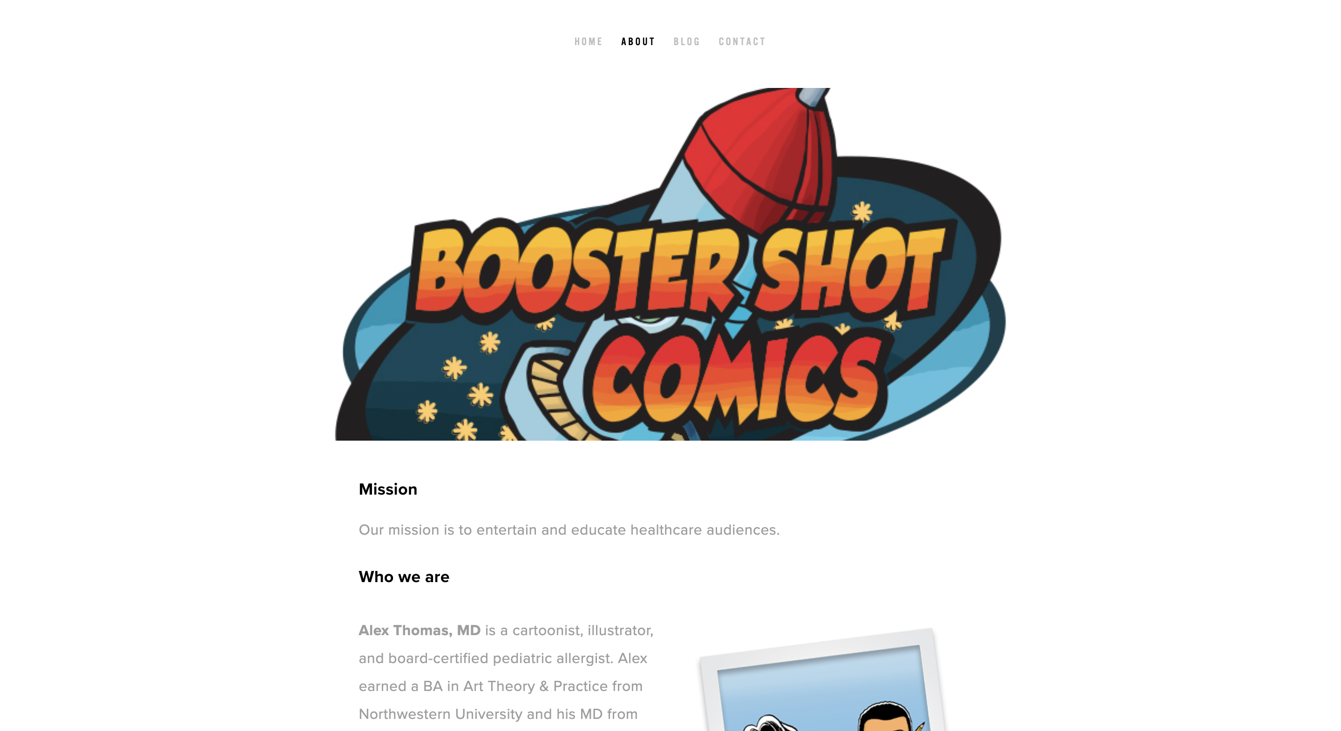
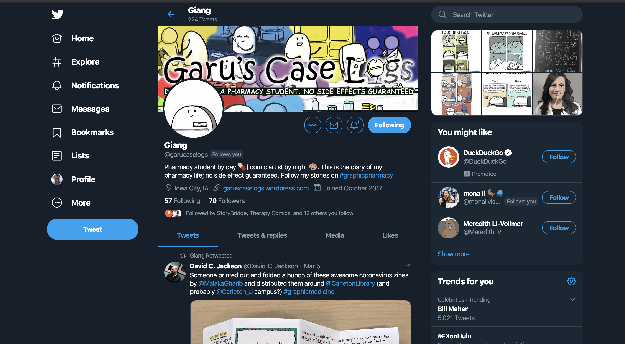
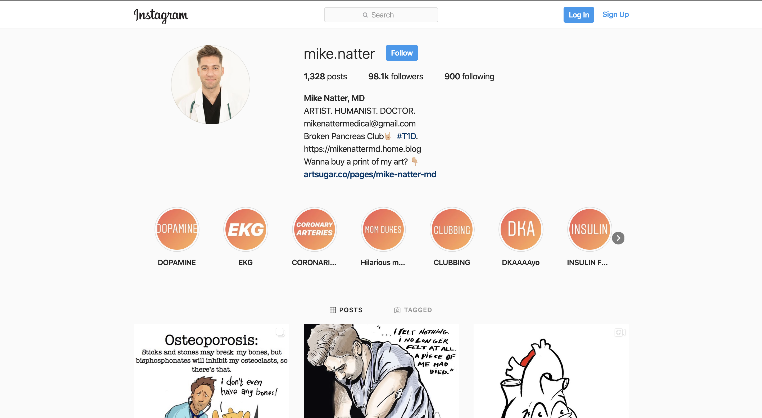
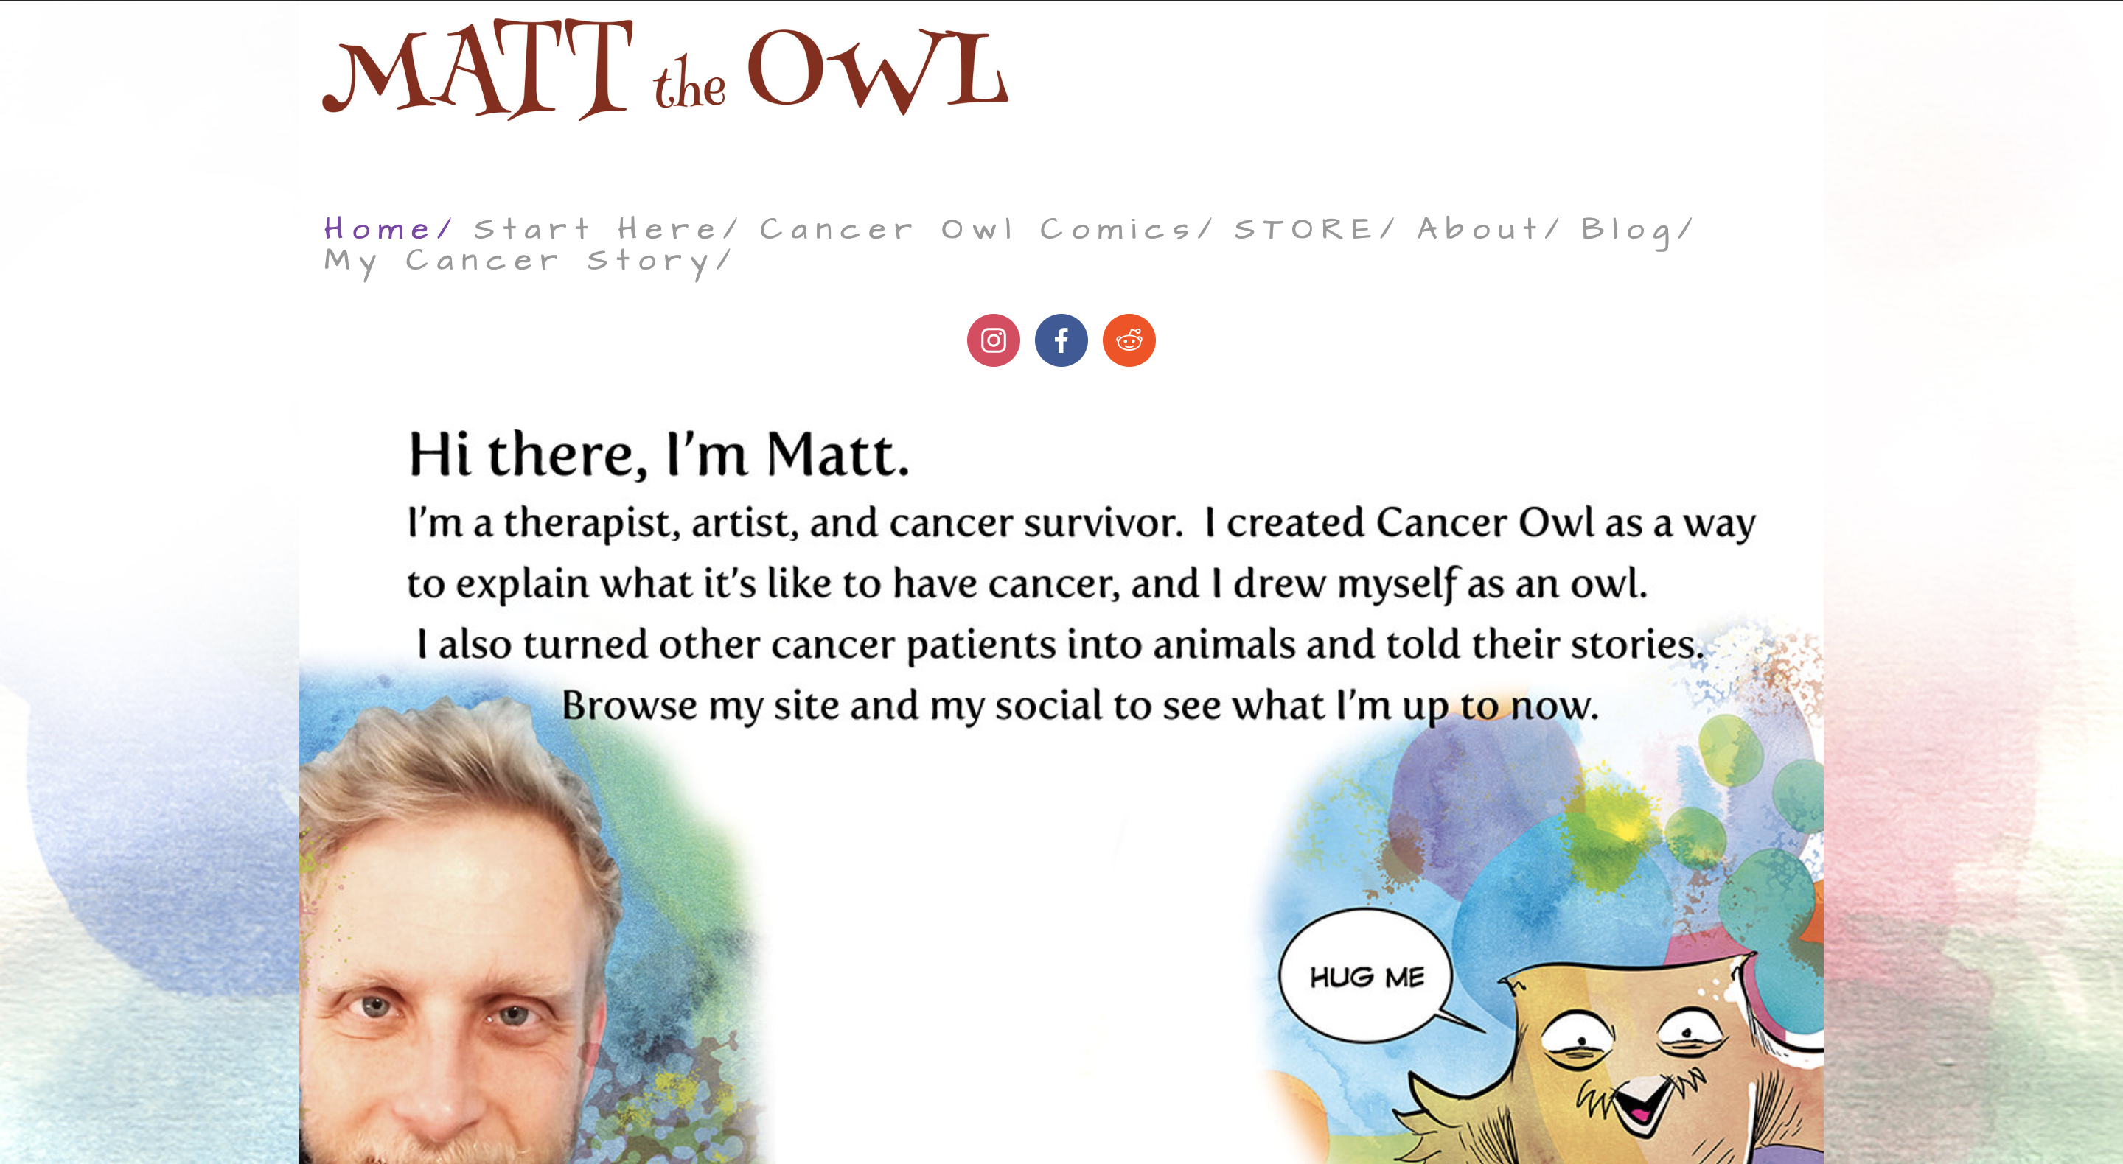
Notes:
Individual creators are also putting their experiences online, offering their GM works instructionally, satirically, and critically. Here, I’m displaying Booster Shot Comics as well as its Instagram feed, most recently on the COVID-19 pandemic. Dr. Mike Natter chronicles his own work as physicians as well as a type-1 diabetic since childhood. Matt Mewhorter is likewise a therapist as well as a cancer survivor, told in comics via his Cancer Owl. And the caselogs of, now graduated, pharmacy student Giang Ho continues on with new comics appearing on their Twitter feed.

Slide 14
RESOURCES
This Photo by Unknown Author is licensed under CC BY
Notes:
Finally, I would like to offer some resources for the further expansion of Graphic Medicine, either creative works therein or scholarship and pedagogy thereupon. I present these as an invitation, lauding the journey already undertaken by GM pioneers but also the immense space still uncharted.

Slide 15
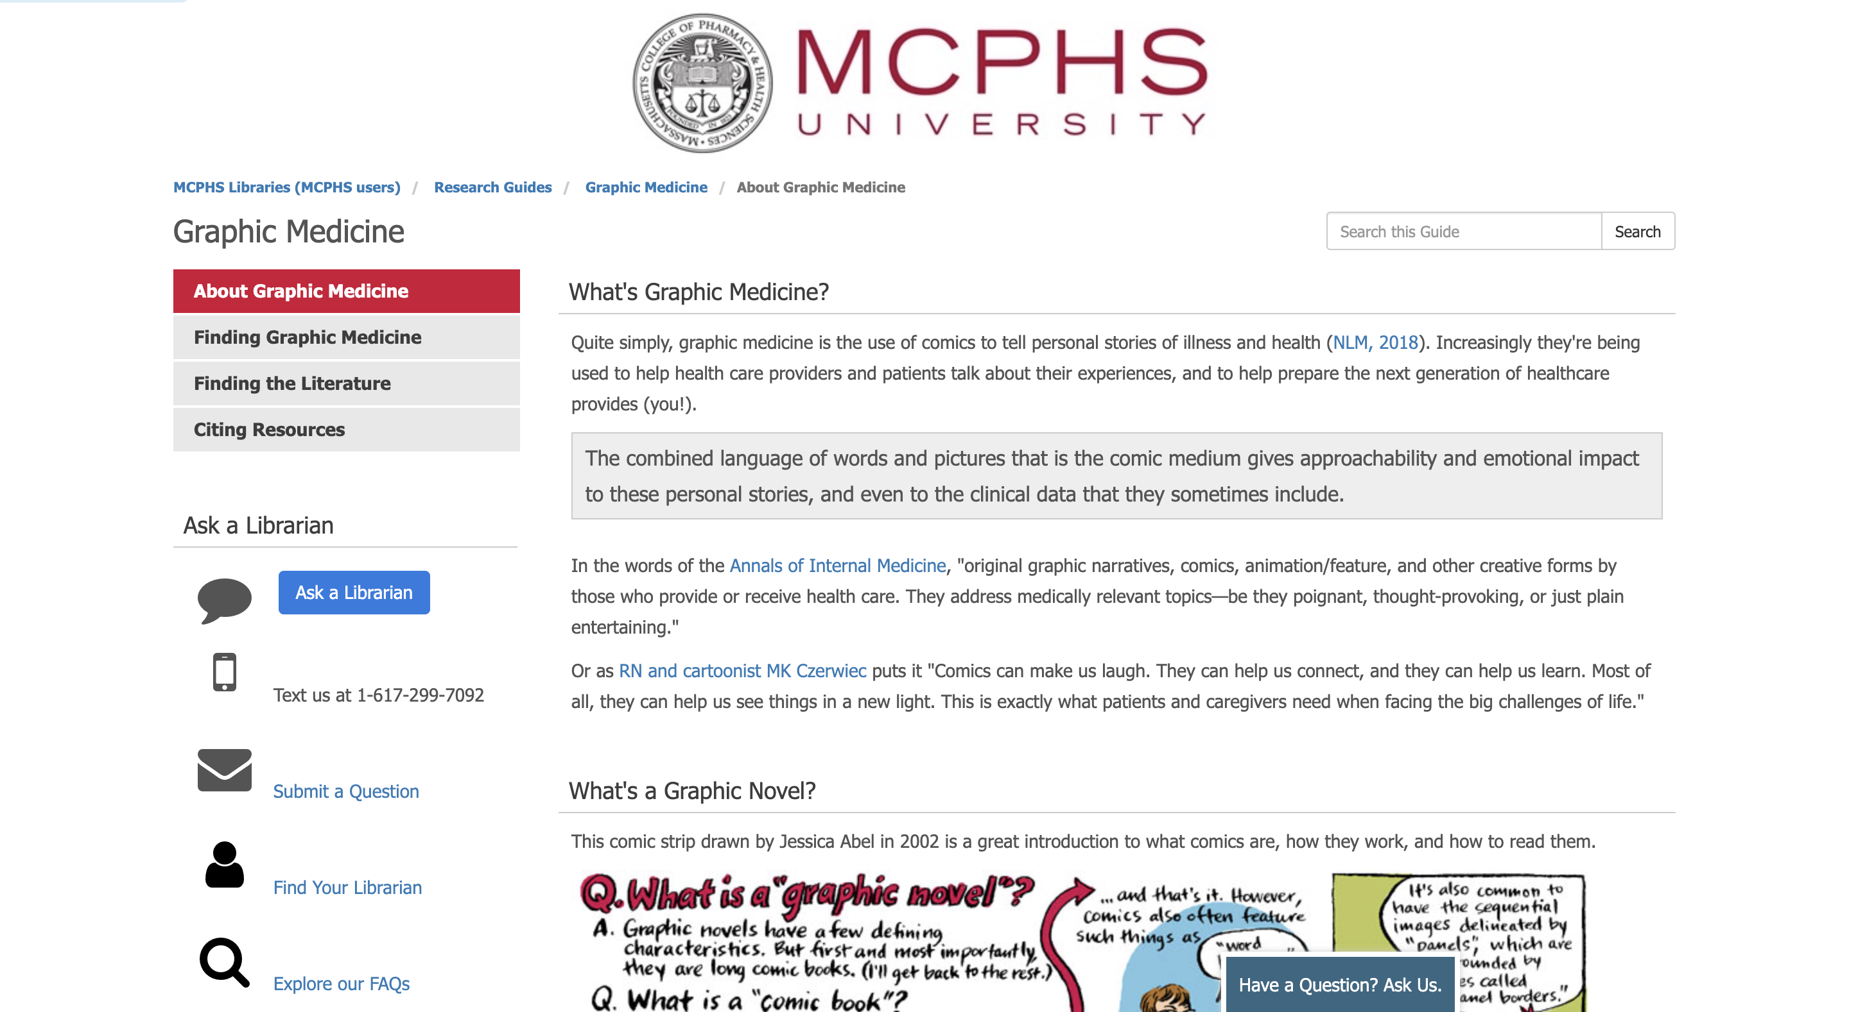
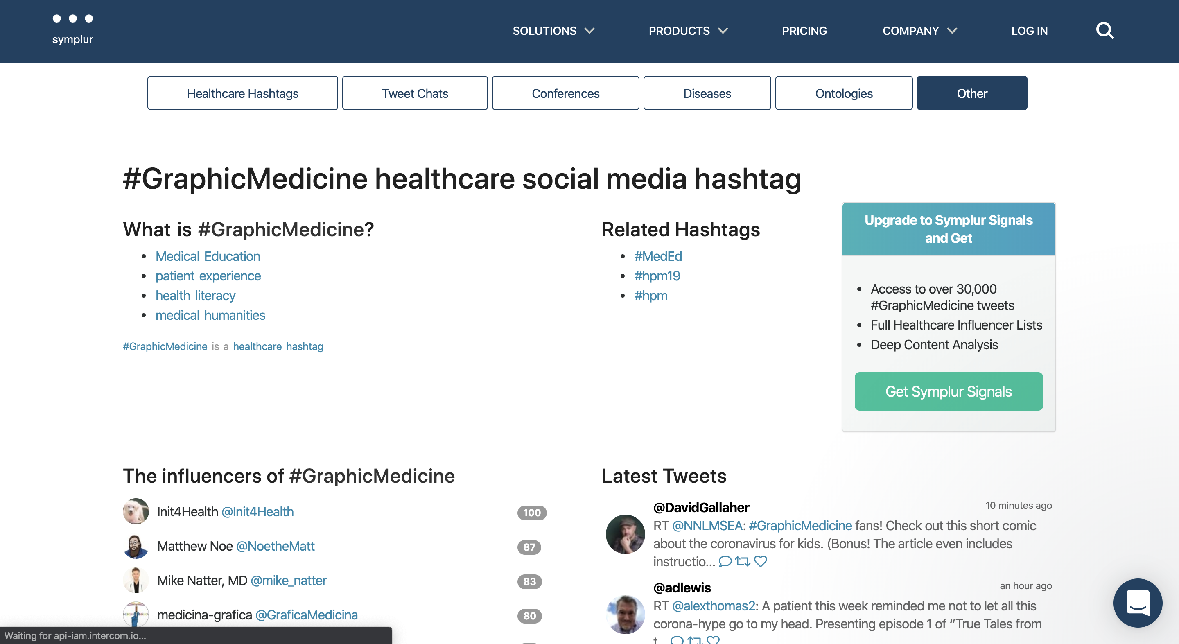
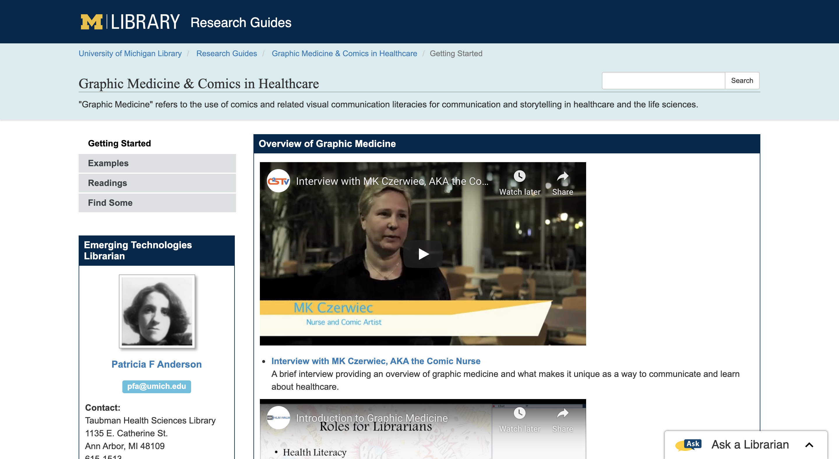
#GraphicMedicine
Notes:
These LibGuides on Graphic Medicine come from the University of Michigan and my own MCPHS University, both delivering research guides and some essential materials in the field. And, for immediate social media discussion of GM, the #GraphicMedicine hashtag, tracked here by Symplur.com, allows one either to lurk or to contribute to unfolding discourse. There’s every chance that this NEMLA presentation is being chronicled there right now!

Slide 16
Graphic Medicine Online
A. David Lewis, PH.D. @adlewis
Additional details and links will be available at https://tinyurl.com/nemla2020.
Notes:
That is my time for today, but I would welcome all of you to continue in this discussion of Graphic Medicine either with me on Twitter (@adlewis) or via any of the online items I covered today. A complete list of them as well as a copy of this presentation will be made available on the GMB site via this link tinyurl.com/nemla2020. Thank you!

